Slide 1
01.02
Basic Operators

Slide 2
Definition(s)
Programmatic Statement: A phrase, or block of code, which the system will interpret and execute the contents of the statement.
Think of this like a sentence in a grammatical concept
Literal: A fixed value in source code
Variable: A user-friendly name that is assigned to some value in memory
Operator: A symbol that denotes an operation within a statement

Slide 3
Programmatic Statement
Similar to a sentence. It has a grammar associated with it.
Encompasses the entire operation for a specific part of code
a = 5
a = someFunction() + someVariable * 5
All Statements!
a

Slide 4
Variable
A symbol assigned that points to some area of memory
Can change over time, and isn’t fixed to a specific type of value
A variable that’s a string now, can be an integer later
a = 5 * 5
Integer
a = “I like cats”
String

Slide 5
Operator
Symbol that denotes an operation
Operator | Meaning
* | Multiplication
- | Subtraction
/ | Division
= | Assignment
+ | Addition
a = 5 * 5
Multiplication Operator

Slide 6
All Together
Operators
Literal
Statement
a = b * 5
Variables

Slide 7
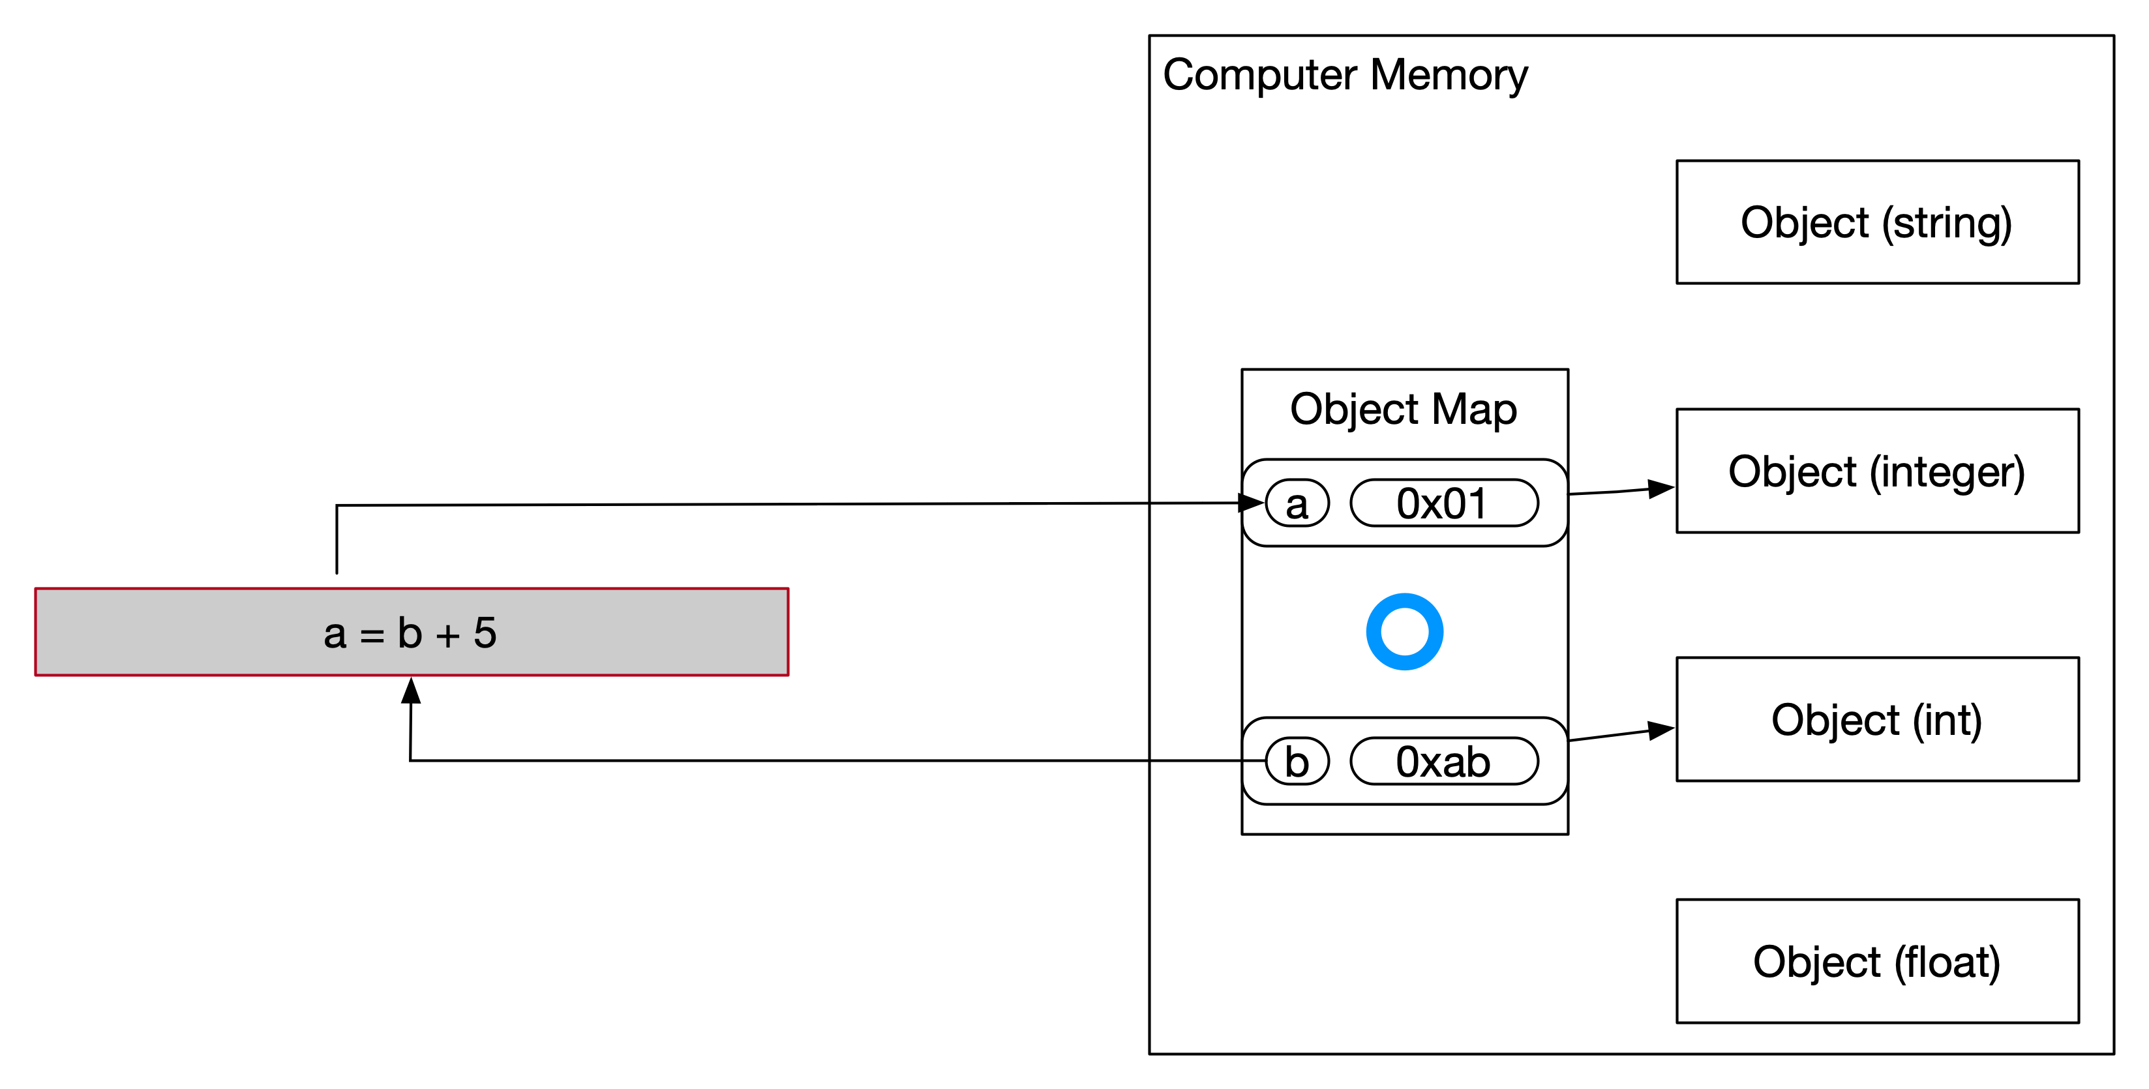
A discussion on memory

Slide 8
Order of Operations
Follows mathematical principles. Same as we had in Algebra
2
3
a = (2 + 5) * 5 * 5
1
4

